Slide 1
Calculo Numérico I Clase Errores de Redondeo
Dr. Luis Sanchez

Slide 2
Objectives
Understanding the distinction between accuracy and precision.
Learning how to quantify error.
Learning how error estimates can be used to decide when to terminate an iterative calculation.
Understanding how roundoff errors occur because digital computers have a limited ability to represent numbers.
Understanding why floating-point numbers have limits on their range and precision.

Slide 3
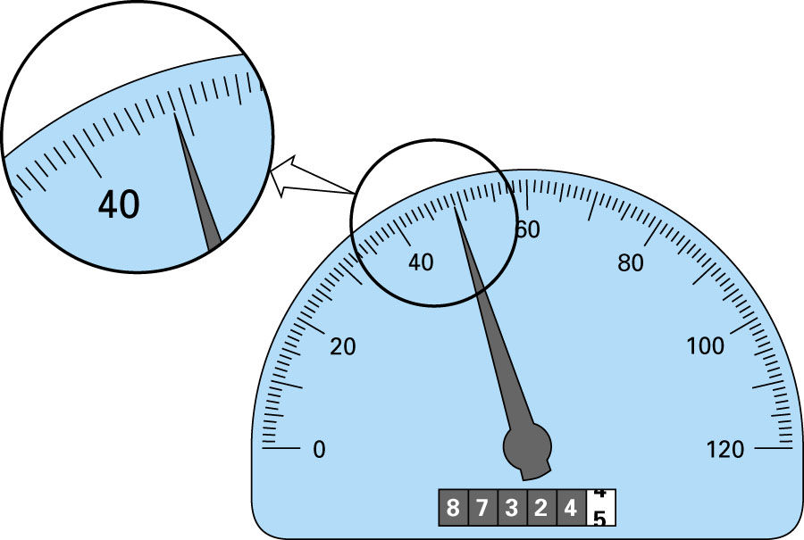
48.9
Significant Digits - Example
Significant digits of a number are those that can be used with confidence, e.g., the number of certain digits plus one estimated digit.

Slide 4
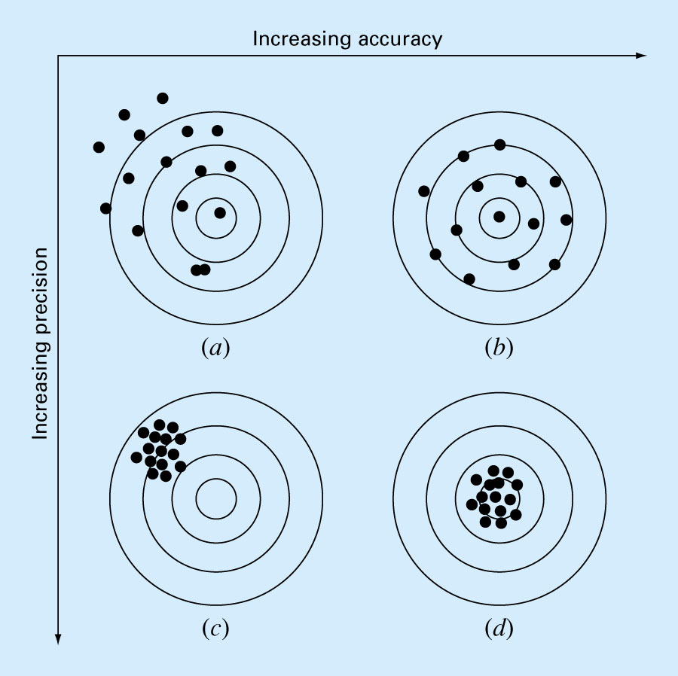
Accuracy and Precision
Accuracy refers to how closely a computed or measured value agrees with the true value, while precision refers to how closely individual computed or measured values agree with each other.
inaccurate and imprecise
accurate and imprecise
inaccurate and precise
accurate and precise

Slide 5
Error Definitions
True error (E_{t}): the difference between the true value and the approximation.
Absolute True error (|E_{t}|): the absolute difference between the true value and the approximation.
True fractional relative error: the true error divided by the true value.
Relative percente error (ε_{t}): the true fractional relative error expressed as a percentage.

Slide 6
Error Definitions – True Error
Can be computed if the true value is known:

Slide 7
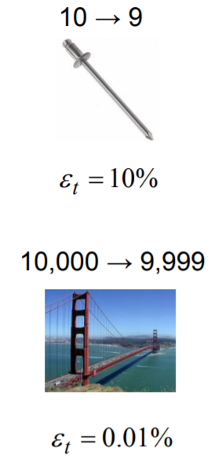
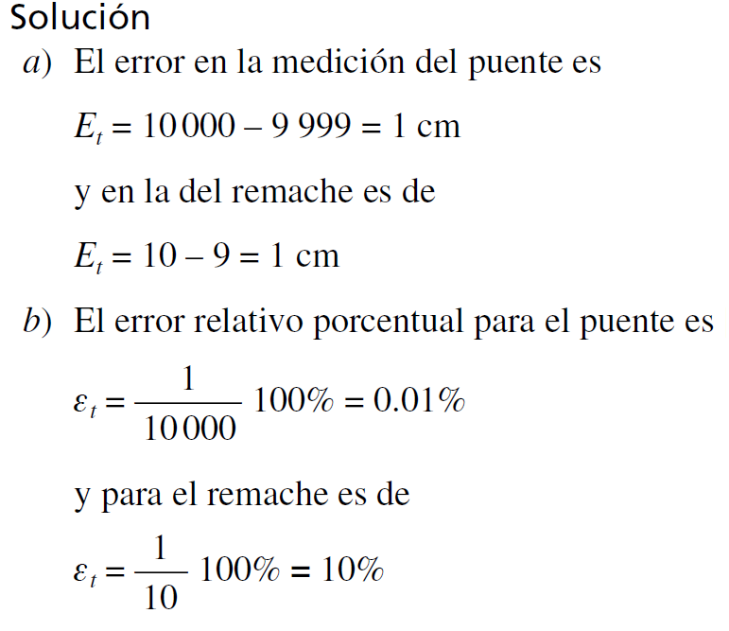
Ejemplo 01:
Suponga que se tiene que medir la longitud de un puente y la de un remache, y se obtiene 9 999 y 9 cm, respectivamente. Si los valores verdaderos son 10 000 y 10 cm, calcule a) el error verdadero y b) el error relativo porcentual verdadero en cada caso.
Por lo tanto, aunque ambas medidas tienen un error de 1 cm, el error relativo porcentual del remache es mucho mayor. Se concluye entonces que se ha hecho un buen trabajo en la medición del puente; mientras que la estimación para el remache dejó mucho que desear.

Slide 8
Error Definitions (cont)
The previous definitions of error relied on knowing a true value. If that is not the case, approximations can be made to the error.
For iterative processes, The approximate relative error the error can be approximated as the difference in values between successive iterations.

Slide 9
Error Definitions – Estimated Error
When the true value is not known:

Slide 10
Using Error Estimates
Often, when performing calculations, we may not be concerned with the sign of the error but are interested in whether the absolute value of the percent relative error is lower than a prespecified tolerance ε_{s}. For such cases, the computation is repeated until | ε_{a} |< ε _{s}
This relationship is referred to as a stopping criterion.

Slide 11


It is also convenient to relate these errors to the number of significant figures in the approximation. It can be shown (Scarborough, 1966) that if the following criterion is met, we can be assured that the result is correct to at least n significant figures.
Ejemplo 02
En matemáticas con frecuencia las funciones se representan mediante series infinitas. Por ejemplo, la función exponencial se calcula usando:
Así cuanto más términos se le agreguen a la serie, la aproximación será cada vez más una mejor estimación del valor verdadero de e. La ecuación anterior se conoce como expansión en series de Maclaurin.
Agregue términos hasta que el valor absoluto del error aproximado e_{a} sea menor que un criterio de error preestablecido es con tres cifras significativas.

Slide 12
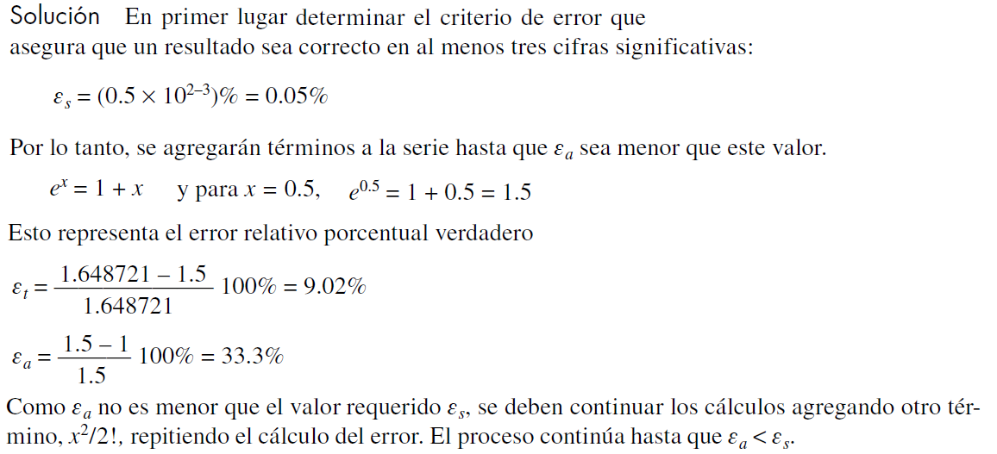
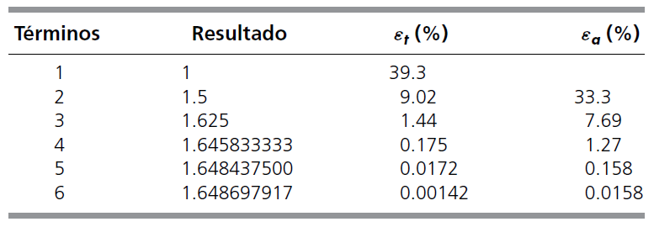

Slide 13
Matlab Script:
% Calculo de exp(x) usando la serie de Maclaurin
x=0.5;
es = 0.0001; % Tolerancia
maxit = 50; % Maximo numero de interacciones
% initialization
iter = 1; sol = 1; ea = 100;
% iterative calculation
while (1)
solold = sol;
sol = sol + x ^ iter / factorial(iter);
iter = iter + 1;
if sol ~= 0
ea = abs((sol - solold)/sol)*100;
end
if ea <= es || iter >= maxit
break
end
end
fx = sol

Slide 14
Roundoff Errors
Roundoff errors arise because digital computers cannot represent some quantities exactly. There are two major facets of roundoff errors involved in numerical calculations:
Digital computers have size and precision limits on their ability to represent numbers.
Certain numerical manipulations are highly sensitive to roundoff errors.

Slide 15
Calculator Example
Suppose you want to compute:
3.578 * 2.139
using a calculator with two-digit fractions
3.57
*
2.13
=
7.60
True answer:
7.653342

Slide 16
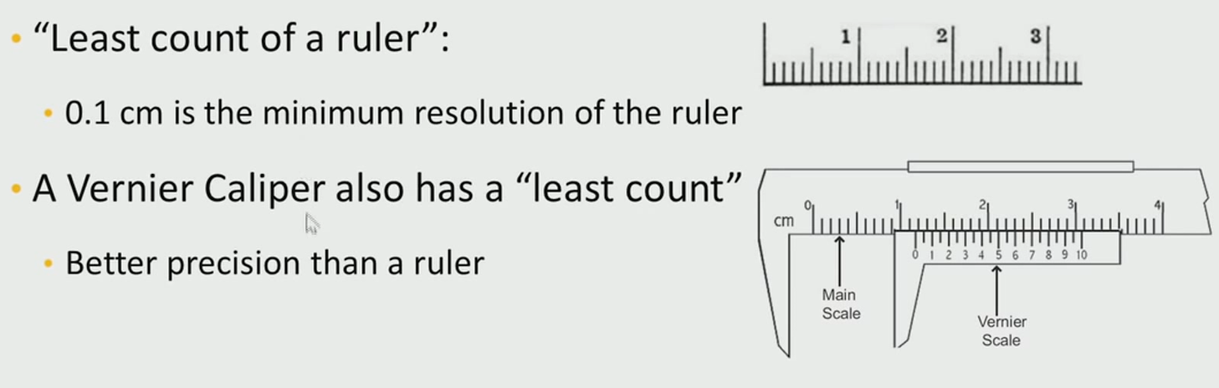
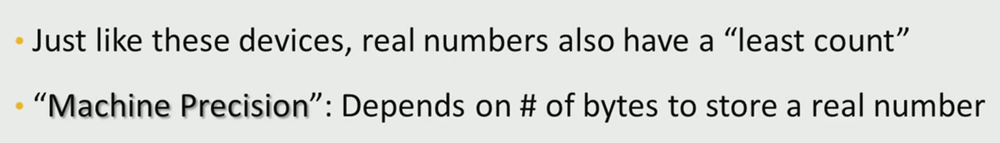
Machine Precisión

Slide 17
Definition: Machine Precision
Machine precision ϵ is defined as the maximum relative error in the floating-point representation of real numbers. In practice, it is the smallest positive real number such that the number (1 + ϵ) can be distinguished from 1.
The machine precision in MATLAB is obtained using the keyword eps. It is typically 2⁻⁵². Consider the following statements typed on the command prompt:
>> x = 1+2^-52;
>> disp(x-1.0)
2.2204e-16
>> x = 1+2^-53;
>> disp(x-1.0)

Slide 18
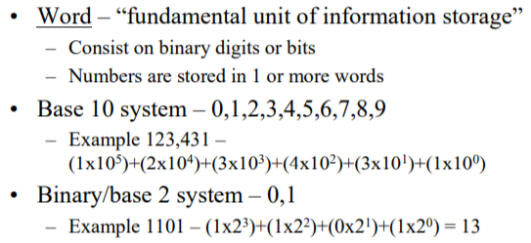
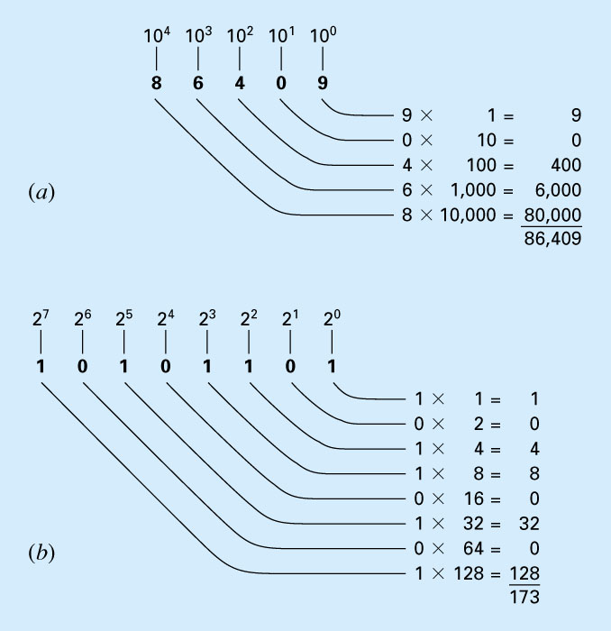
Computer Number Representation
Cómo trabajan los sistemas a) decimal (base 10) y b) binario (base 2). En b) el número binario 10101101 es equivalente al número decimal 173.

Slide 19
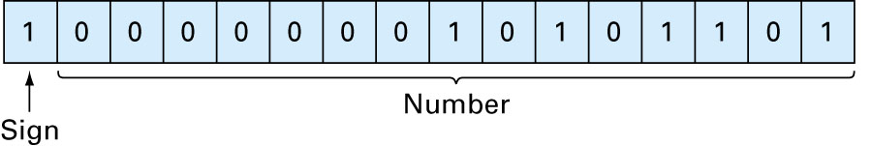
Integer Representation
La representación de un entero decimal –173 en una computadora de 16 bits usando el método de magnitud con signo.
Signed binary numbers or signed magnitude method:
S = 1 if negative S = 0 if positive

Slide 20
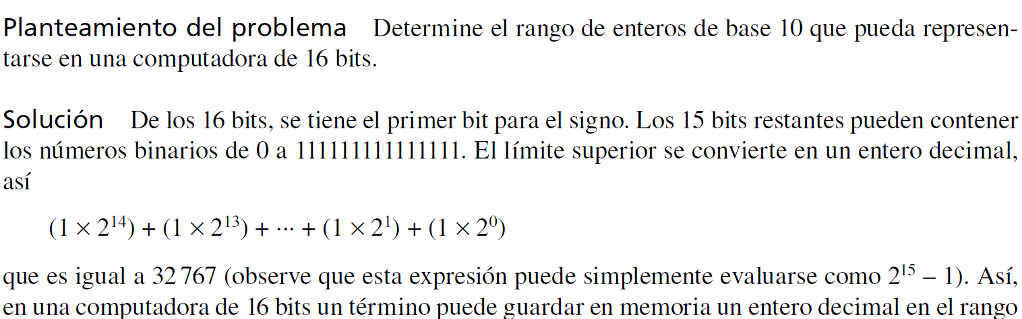
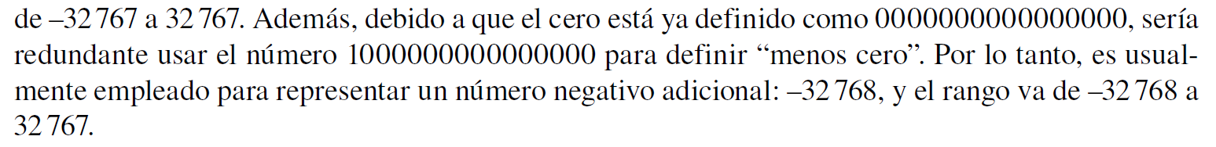
Rango de Enteros

Slide 21
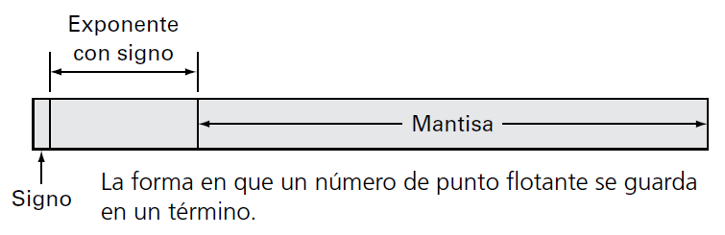
Floating-Point Representation
Numbers such as π, e, or cannot be expressed as before.
Fractional quantities are typically represented in computer using “floating point” form.
Integer part
exponent
mantissa
Base of the number system used

Slide 22
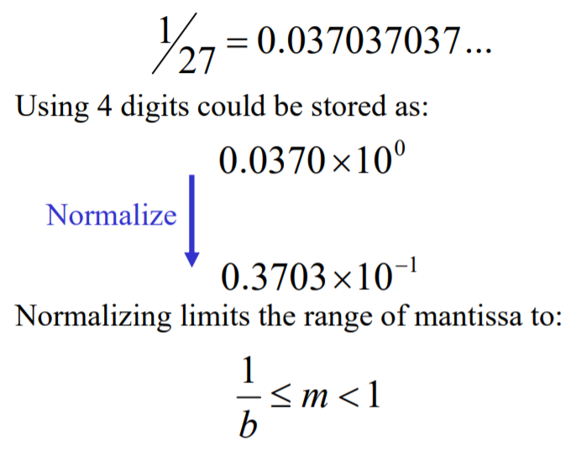
Floating-Point Normalized Representation Example
En un sistema de base 10 con punto flotante,
que únicamente permite guardar cuatro lugares decimales
donde b = la base. Por ejemplo, para un sistema de base 10, m estaría entre 0.1 y 1; y para un sistema de base 2, entre 0.5 y 1.

Slide 23
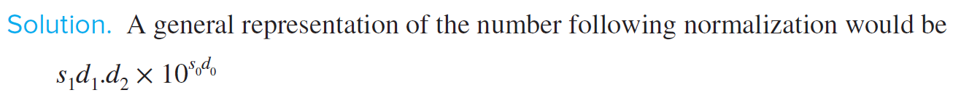
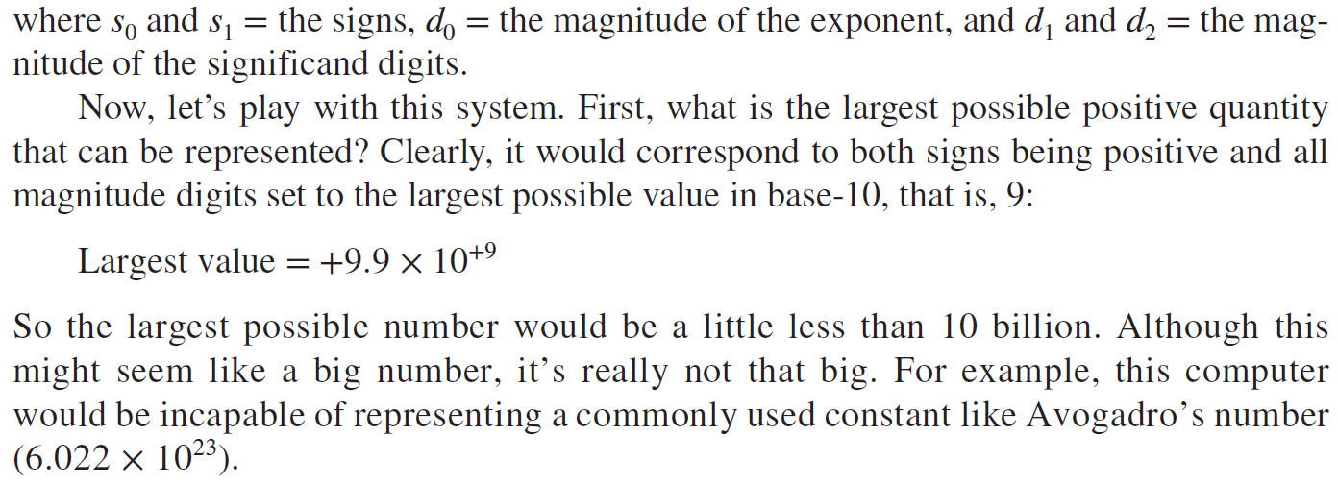
Implications of Floating-Point Representation
Suppose that we had a hypothetical base-10 computer with a 5-digit word size. Assume that one digit is used for the sign, two for the exponent, and two for the mantissa. For simplicity, assume that one of the exponent digits is used for its sign, leaving a single digit for its magnitude.

Slide 24
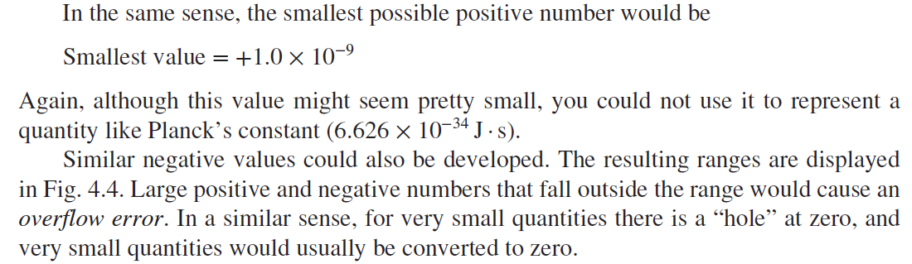
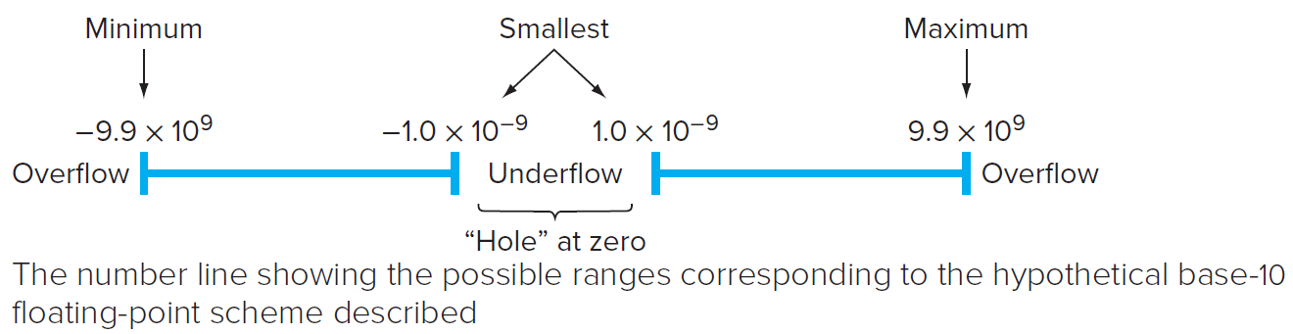

Slide 25
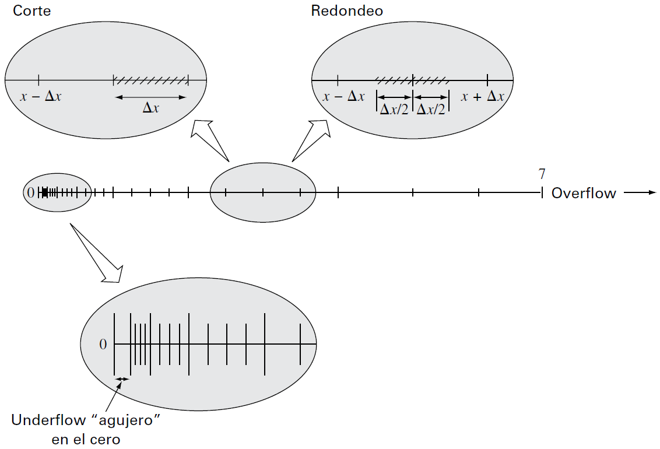
Existe sólo un número finito de cantidades que puede representarse dentro de un rango
Sistema numérico hipotético desarrollado en el ejemplo. Cada valor se indica con una marca.

Slide 26
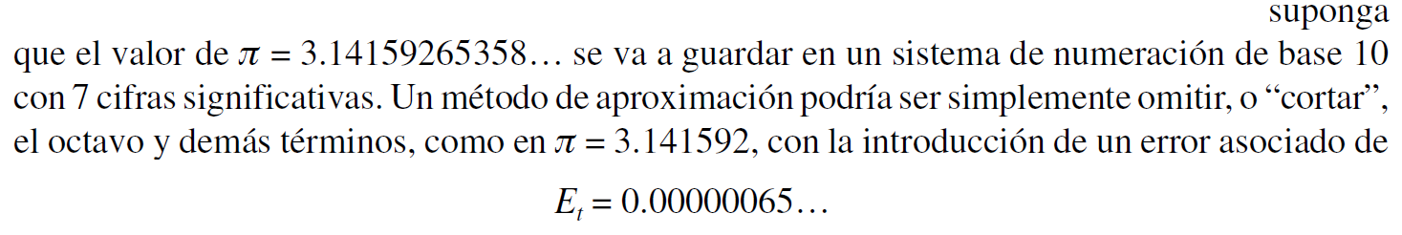
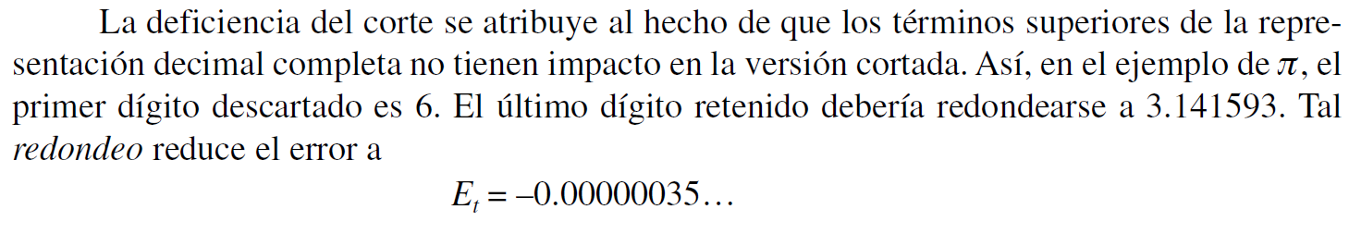
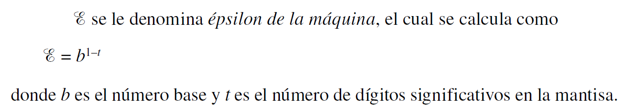
A los errores ocasionados por la aproximación en ambos casos se les conoce como errores de cuantificación. La aproximación real se realiza por dos caminos: cortando o redondeando.
Corte:
Redondeo:

Slide 27
IEEE 754 Floating-Point Standard
Single Precision (32-bit representation)
1-bit Sign + 8-bit Exponent + 23-bit Fraction
Double Precision (64-bit representation)
1-bit Sign + 11-bit Exponent + 52-bit Fraction
S
Exponent⁸
Fraction²³
S
Exponent¹¹
Fraction⁵²
(continued)

Slide 28
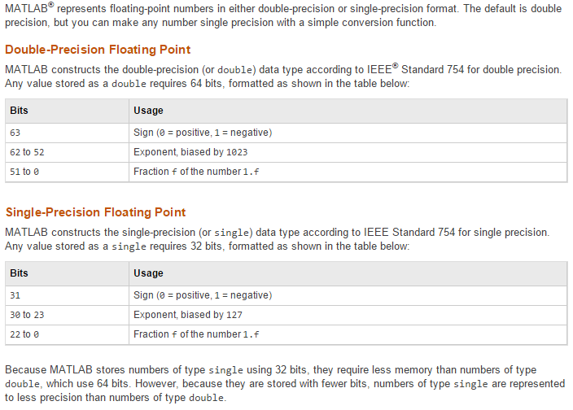
Representing Real Numbers In Matlab

Slide 29
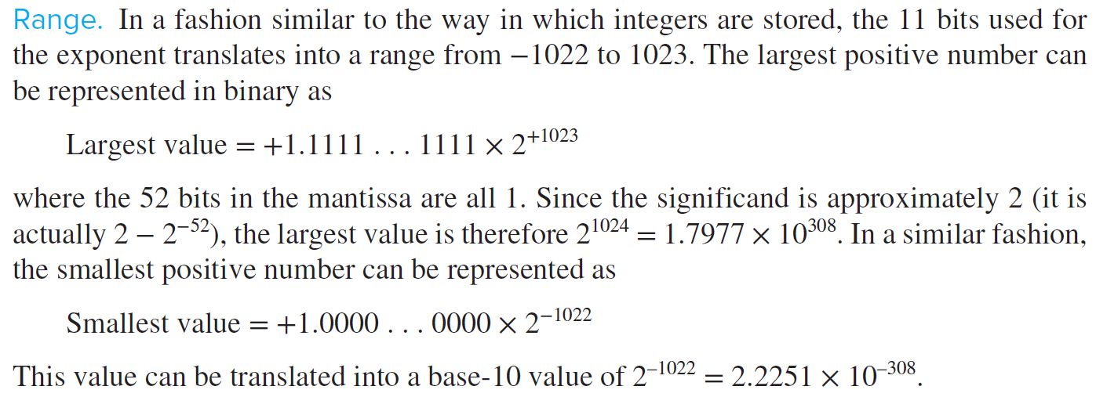
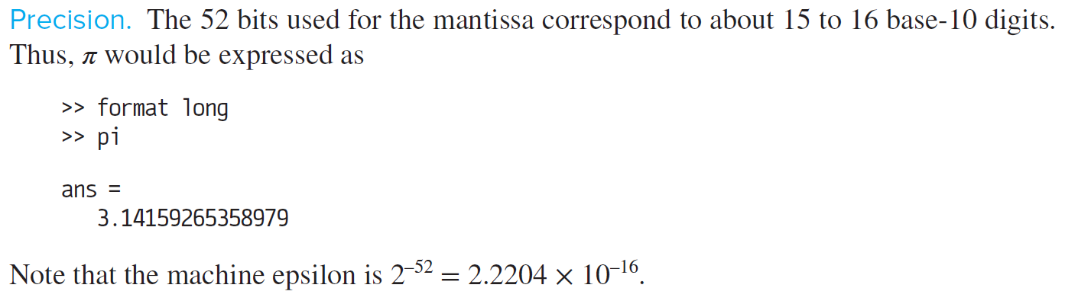
For Matlab Numeric Doble precision Data

Slide 30
As good as it gets on our PCs …
-1.797693134862316 x 10³⁰⁸
1.797693134862316 x 10³⁰⁸
0
- Overflow
15 significant
figures
Underflow
15 significant
figures
Overflow +
“Hole”
on either
side of
zero
-2.225073858507201 x 10⁻³⁰⁸
2.225073858507201 x 10⁻³⁰⁸
For 64-bit, IEEE double precision format systems

Slide 31
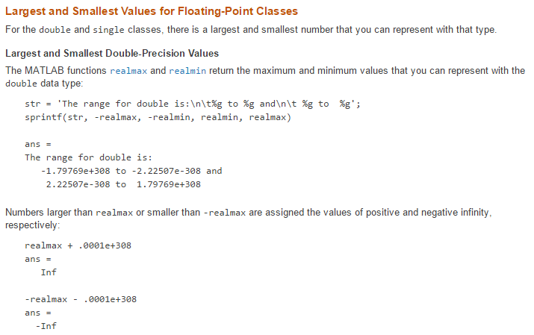
Largest and Samalles Values In Matlab

Slide 32
Round-Off Error and Common Arithmetic Operations
Addition
Mantissa of number with smaller exponent is modified so both are the same and decimal points are aligned
Result is chopped
Example: hypothetical 4-digit mantissa & 1-digit exponent computer
0.1557 x 10¹ + 0.4341 x 10⁻¹ = 0.1557 x 10¹ + 0.004341 x 10¹ (so they have same exponent)
= 0.160041 x 10¹ = 0.1600 x 10¹ (because of 4-digit mantissa)
Subtraction
Similar to addition, but sign of subtrahend is reversed
Severe loss of significance during subtraction of nearly equal numbers → one of the biggest sources of round-off error in numerical methods – subtractive cancellation

Slide 33
Round-Off Error and Large Computations
Even though an individual round-off error could be small, the cumulative effect over the course of a large computation can be significant!!
Large numbers of computations
Computations interdependent
Later calculations depend on results of earlier ones

Slide 34
Particular Problems Arising from Round-Off Error (1)
Adding a small and a large number
Common problem in summing infinite series (like the Taylor series) where initial terms are large compared to the later terms.
Mitigate by summing in the reverse order so each new term is comparable in size to the accumulated sum (add small numbers first).
Subtractive cancellation
Round-off error induced from subtracting two nearly equal floating-point numbers.
Example: finding roots of a quadratic equation or parabola.
Mitigate by using alternative formulation of model to minimize problem.

Slide 35
Particular Problems Arising from Round-Off Error (2)
Smearing (dispercion)
Occurs when individual terms in a summation are > summation itself (positive and negative numbers in summation)
Really a form of subtractive cancellation – mitigate by using alternative formulation of model to minimize problem
Inner Products
Common problem in solution of simultaneous linear algebraic equations
Use double precision to mitigate problem (MATLAB does this automatically)

Slide 36
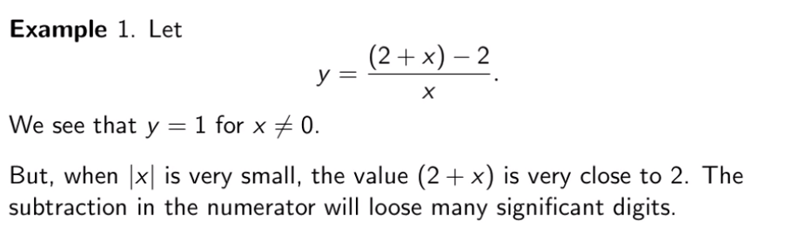
Some Examples
We run the following code in Matlab:
>> x=10.^(-12:-1:-16); y=((2+x)-2)./x;
>> format short e; [x;y]
Ans=

Slide 37
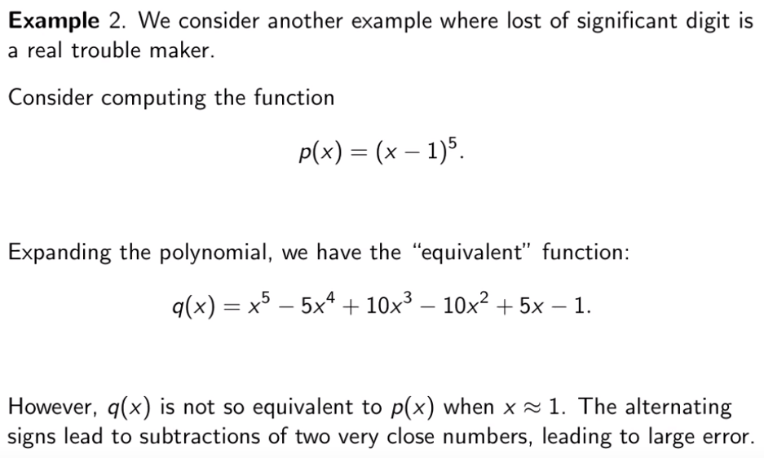

Slide 38

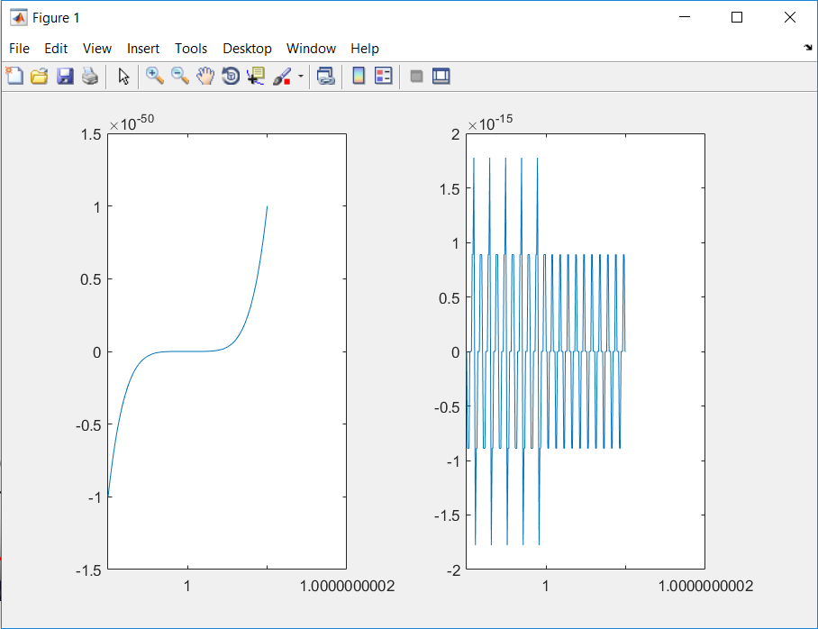
Try the following code in Matlab:
>> x=[1-10^(-10):10^(-12):1+10^(-10)];
>> p=(x-1).^5;
>> q=x.^5-5*x.^4+10*x.^3-10*x.^2+5*x-1;
>> subplot(1,2,1); plot(x,p);
>> subplot(1,2,2); plot(x,q);

Slide 39
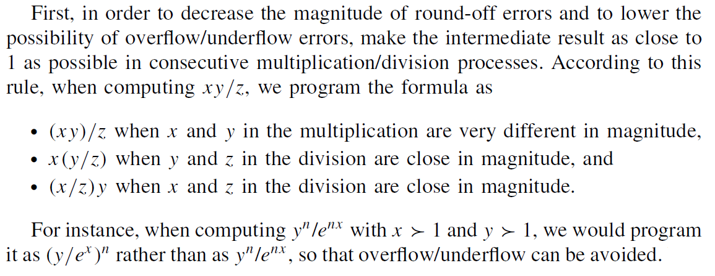
Tips for Avoiding Large Errors
clear
clc
x=36; y=10^16;
for n=[-20 -19 19 20]
fprintf('y^n/exp(n*x)=%25.15e\n', y^n/exp(n*x));
fprintf('(y/exp(x))^n=%25.15e\n', (y/exp(x))^n);
end

Slide 40
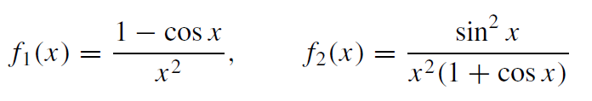
Second, in order to prevent ‘loss of significance’, it is important to avoid a ‘bad subtraction’ —that is, a subtraction of a number from another number having almost equal value
For another instance, we consider the following two formulas, which are analytically the same, but numerically different:
It is safe to use f1(x) for x ≈ π since the term (1 + cos x) in f2(x) is a ‘bad subtraction’, while it is safe to use f2(x) for x ≈ 0 since the term (1 − cos x) in f1(x)
is a ‘bad subtraction’.

